Slide 1

Farm Financer
Farm Financer is a digital platform designed to support farmers and agricultural businesses in securing reliable and flexible financial assistance.
Group: 2
Dev Squad

Slide 2
Farm Financer: A Full-Stack Web Application
Farm Financer is a digital platform designed to support farmers and agricultural businesses in securing reliable and flexible financial assistance. The platform offers a comprehensive selection of loan options tailored to various agricultural needs, such as crop cultivation, farm equipment purchases, and land expansion. Each loan is accompanied by detailed descriptions, competitive interest rates, and clear terms and conditions, empowering users to make informed decisions.
Farm Financer ensures that farmers can access the financial support they need with ease, providing a seamless and user-friendly application process to help grow their agricultural ventures.

Slide 3
Tech Stack Used
The Farm Financer leverages a modern, layered architecture to ensure robust performance, scalability, and maintainability. Each layer is meticulously chosen to provide optimal functionality and seamless integration, forming a cohesive full-stack ecosystem.
Frontend
Backend API
Built with Angular, utilizing TypeScript for strong typing, HTML for structure, and CSS for efficient styling. Provides a dynamic and responsive user interface across all devices.
Developed using .NET Core Web API with C#, providing a powerful and secure foundation for all server-side logic and data interactions.
Database
Authentication
JWT (JSON Web Token) is implemented for secure, stateless authentication, ensuring protected API endpoints and user sessions.
Microsoft SQL Server manages all persistent data, with Entity Framework Core simplifying data access and object-relational mapping.

Slide 4
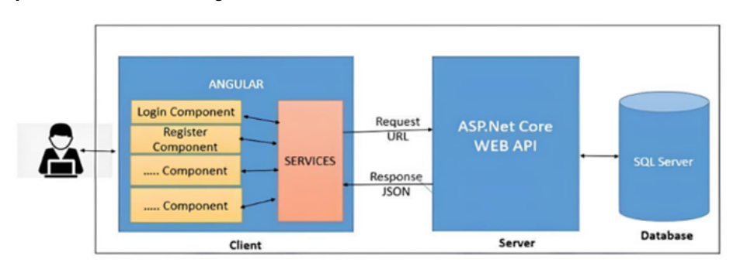
Architecture Overview
The backend uses ASP.NET Core Web API, where controllers handle HTTP requests sent from Angular services.
These controllers process the requests, interact with the SQL Server database, and return JSON responses.

Slide 5
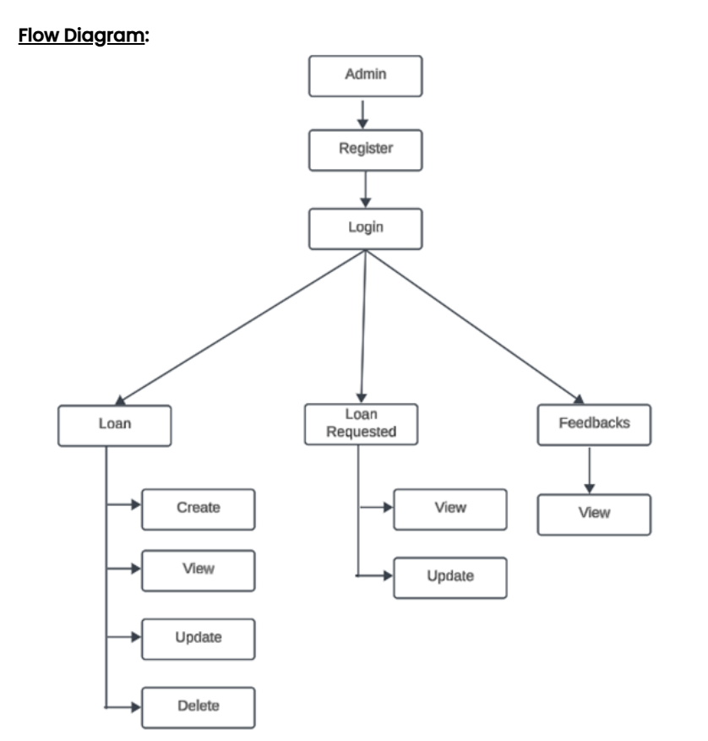
UML Diagram (Admin)
This workflow shows a simple system where an Admin first registers and logs in. After logging in, they can manage three main sections: Loans, Loan Requests, and Feedbacks.
In the Loans section, they can create, view, update, or delete loan records.
In Loan Requests, they can view and update request details.
In the Feedbacks section, they can only view feedback submitted by users.

Slide 6
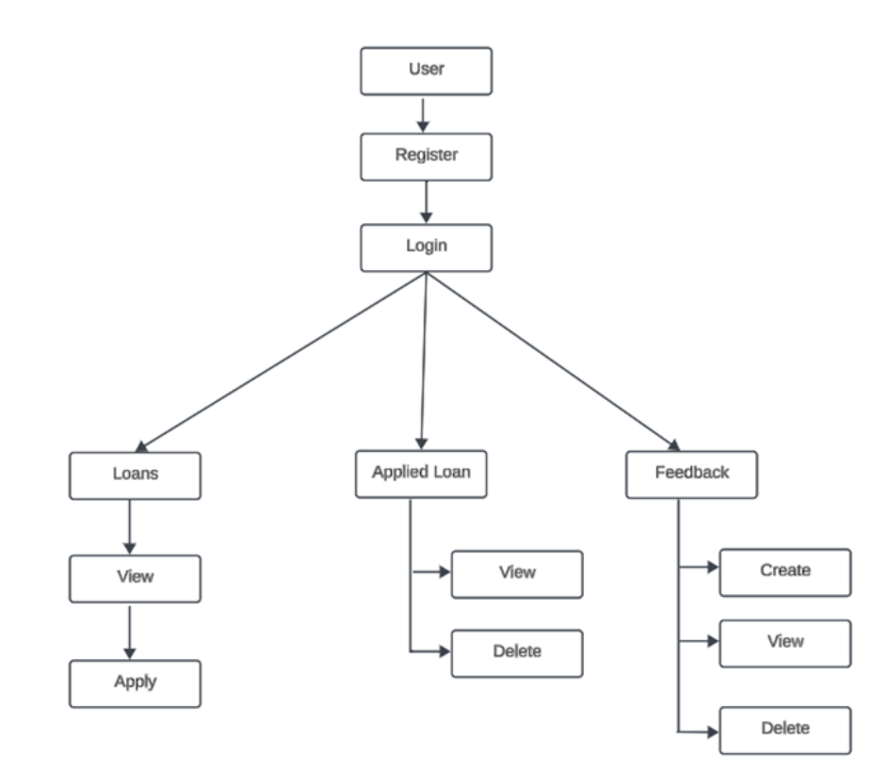
UML Diagram (User)
This UML diagram represents a simple user workflow. A User first registers and logs in. After logging in, they can access three main sections: Loans, Applied Loan, and Feedback.
In the Loans section, users can view available loans and apply for one.
Under Applied Loan, they can view or delete their submitted loan applications.
In the Feedback section, users can create, view, or delete feedback entries.

Slide 7
WebApi Overview (Backend)
The backend of the website handles communication between the user interface and the database through RESTful APIs.
When a user performs actions like login, loan application, or feedback submission on the frontend, HTTP requests are sent to the backend server.
The backend processes these requests, applies validation and business logic, then interacts with the database to store or retrieve data.
Responses are sent back to the frontend in JSON format, updating the user interface accordingly.
Security measures like authentication, input validation, and role-based access control ensure safe and structured data handling.

Slide 8
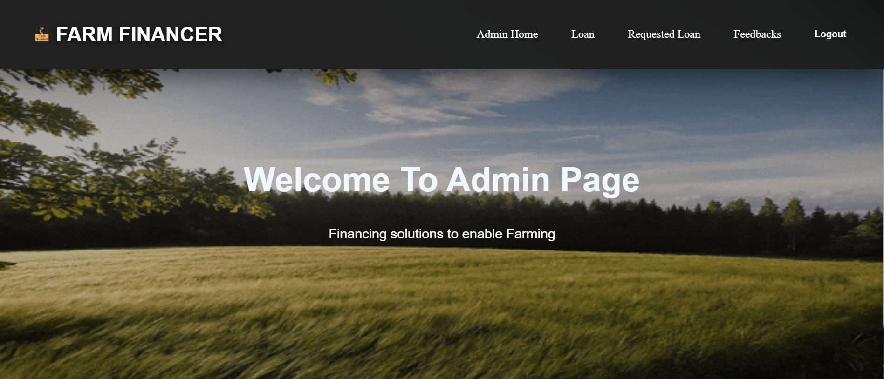
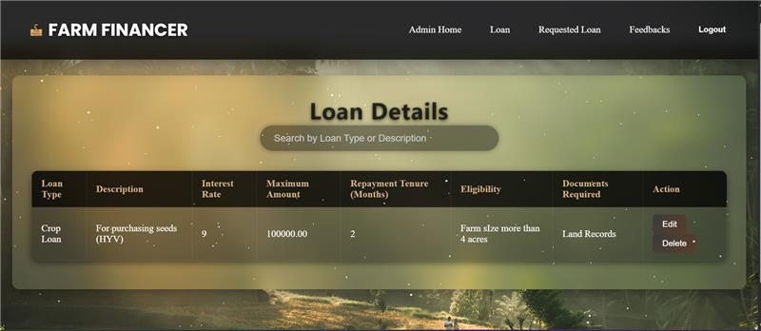
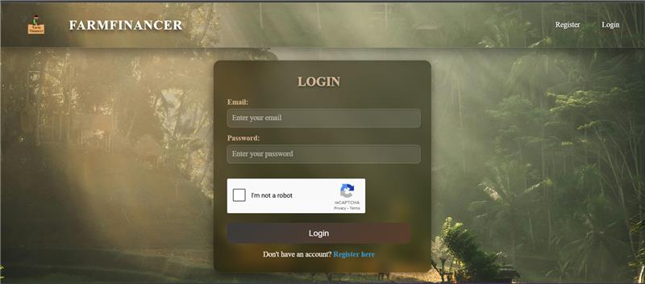
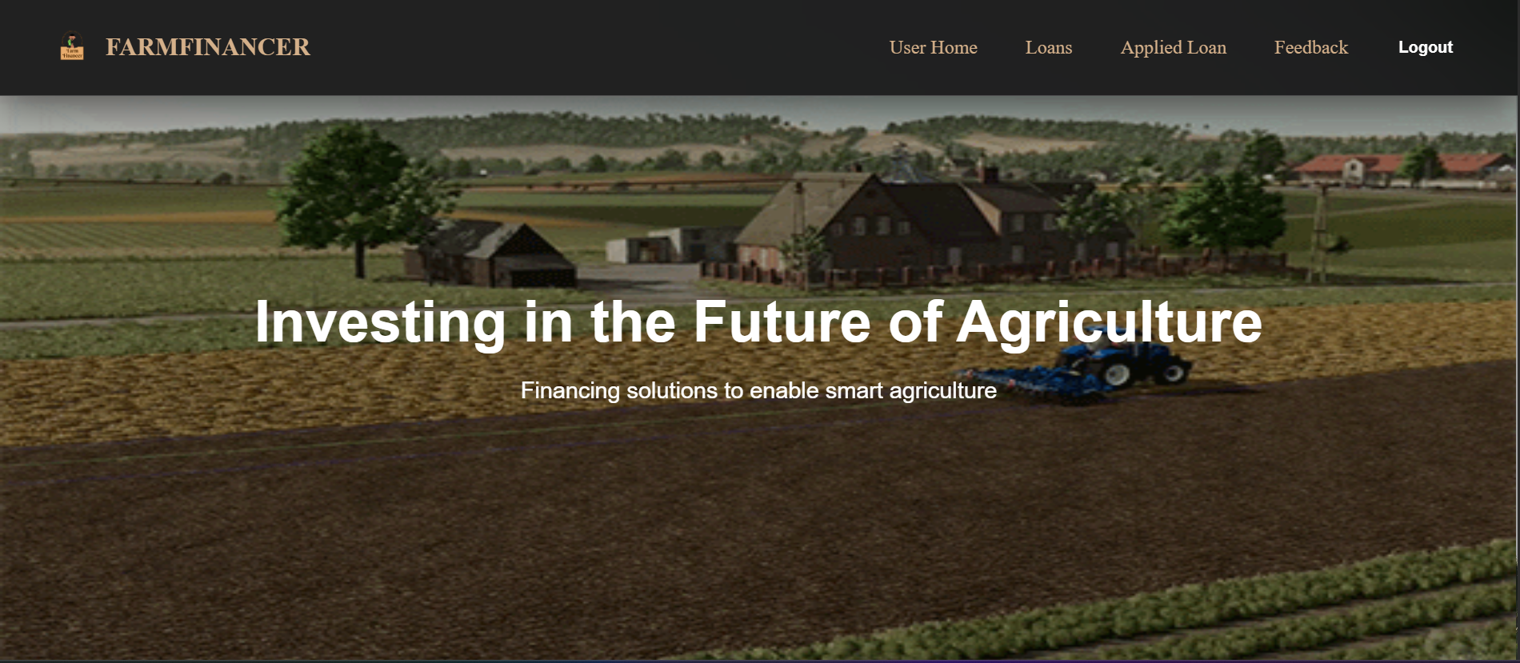
Snapshots

Slide 9
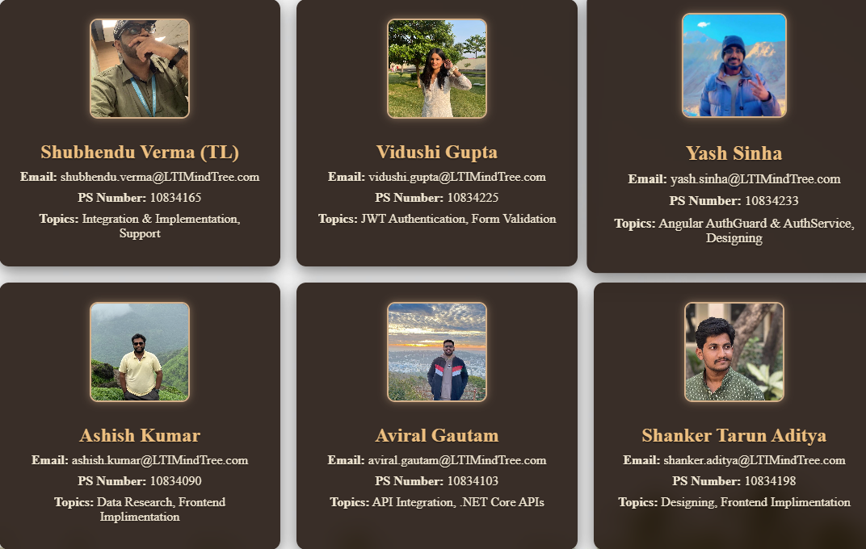
Thank You!

